Slide 1



Azure Data Lakes: A Comprehensive Guide
Dada Joshua

Slide 2
What is a Data Lake?
1
A centralized repository for all types of data
2
Azure Data Lake Storage
3
Perfect for big data analytical workloads
A cloud-based solution for storing and analyzing massive amounts of data in any format.
Storing data in its raw format reduces the need to conform to an existing structure, making it easier to access and analyze.
Provides a single location for data ingestion and easy access using various frameworks.

Slide 3
Azure Data Lakes in a Nutshell
Scalability
Diverse Data Support
Data lakes can handle huge volumes of data and seamlessly scale to meet growing demand.
Data lakes enable storage of various data formats, from structured to unstructured.
Efficient Analysis
Unmatched Flexibility
With data lakes, analyzing data becomes more efficient, thanks to sophisticated querying capabilities.
Data lakes provide a scalable and flexible platform for data processing and analysis.

Slide 4

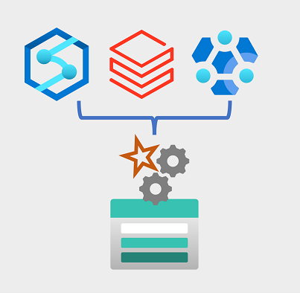
Azure Data Lake Gen1
Azure Data Lake Storage Gen1 is designed to manage large-scale data storage and processing. It supports popular tools like Hadoop and Spark and can handle both structured and unstructured data. Additionally, it's enhanced by its integration with Azure Active Directory for robust security and access control.

Slide 5

Azure Data Lake Gen1: The Essential Features
1
Open data formats
2
Robust Security
3
Structured and Unstructured Data Support
Azure Data Lake Gen1 supports open data formats and popular analytics tools, such as Hadoop and Spark.
Azure Active Directory integration ensures robust access control and authentication mechanisms.
Azure Data Lake Gen1 efficiently manages both structured and unstructured data, making it a flexible solution for data exploration.

Slide 6
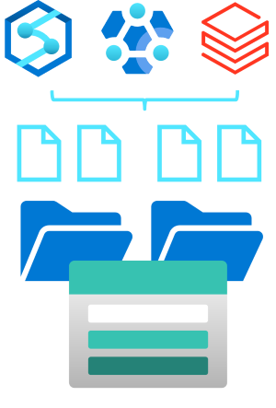
Azure Data Lake Gen2
Azure Data Lake Gen2 offers an evolutionary progression from Gen1 with its hierarchical file system structure, integration with Azure Blob Storage, versatility in handling data, and enhanced scalability and performance. It provides a comprehensive storage solution for both structured and unstructured data.

Slide 7
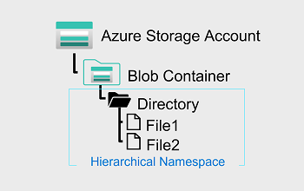
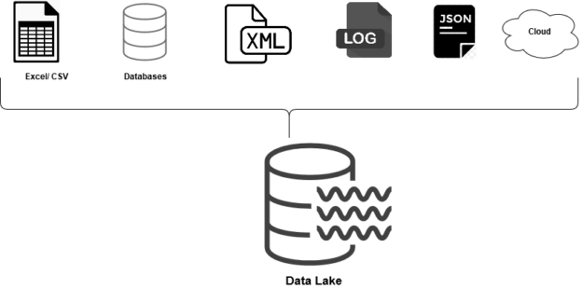

Azure Data Lake Gen2: A Closer Look
Hierarchical File System
Structured and Unstructured Data Support
Scalability and Performance
Azure Data Lake Gen2 features a hierarchical file system structure that enhances data organization.
With Azure Data Lake Gen2, enjoy heightened scalability and performance to keep your data solutions running smoothly.
Azure Data Lake Gen2 is adept at accommodating both structured and unstructured data.

Slide 8
Setting Up an Azure Data Lake Gen2 Account
1
Sign into Azure Portal
Getting started with Azure Data Lake Gen2 is easy and can be done through the Azure portal.
2
Create or Select Resource Group (Optional)
Use Azure RBAC and ACLs for precise and effective permission management
3
Create a Storage Account
Create and Enable "Hierarchical namespace" (this is the feature that turns your storage account
into Azure Data Lake Storage Gen2)
4
Review and Create
Click on "Create" to create the storage account. The deployment might take a few minutes

Slide 9
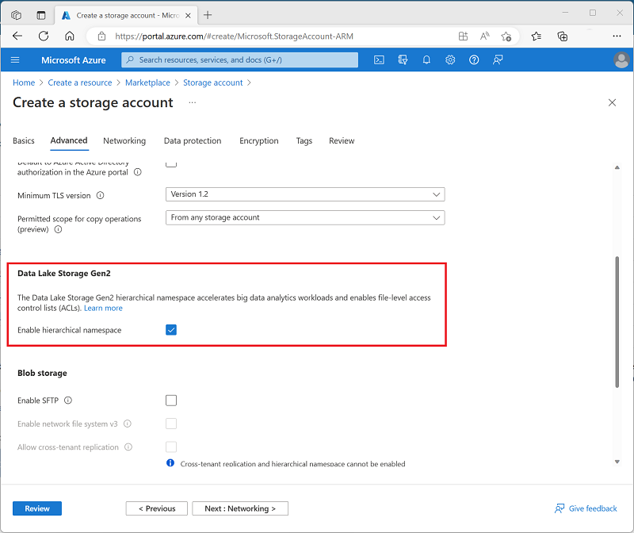

Slide 10
Data Ingestion and Management in Data Lake Gen2
Data Ingestion Methods
File Naming and Organization
Data Replication
Data replication is critical for maintaining data integrity, disaster recovery, and ensuring data is always available.
Azure Data Factory
Use structured folder systems, systematic file naming approaches, and data partitions to enhance data accessibility.
Azure Databricks
Azure HDInsight

Slide 11
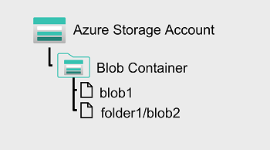
Data Lake vs. Other Azure Storage Solutions
Data Lake Gen2
Blob Storage
Azure Table Storage
Structured storage
Object storage
Structured NoSQL storage
Scalability and complex querying
Unstructured data types like images and videos
Structured data types
A more powerful solution for advanced analytics
Simple storage for everyday scenarios
Designed for specific use cases like IoT

Slide 12
Security and Compliance in Azure Data Lake Gen2
Access Control
Data Security
Auditing and Monitoring Capabilities
Access control mechanisms such as Azure RBAC and ACLs are in place to ensure fine-grained permission management.
Data is encrypted at rest using Azure Storage Service Encryption and in transit using HTTPS, ensuring data security.
Robust auditing and monitoring capabilities track data access and modifications for compliance and security.

Slide 13

Advanced Topics and Best Practices for Azure Data Lakes
1
Data Partitioning Strategies
2
Indexing for Faster Querying
Advanced data partitioning strategies enhance querying efficiency and performance significantly.
Indexing reduces data scans, improving speed and performance when querying a data lake.
3
Custom Applications with Azure Data Lake Store SDK
4
Data Transformation Strategies
ETL, ELT and data warehousing patterns enhance data transformation and analysis.
Azure Data Lake Store SDK enables users to create custom apps for programmatic interactions with the platform.
5
Data Schema Design
6
Data Naming Conventions
Thoughtful data schema design considers scalability and compatibility with analytics tools.
Use consistent data naming conventions for discoverability and maintenance.
7
Versioning and Metadata Management
8
Data Quality Checks and Cleanup
Versioning and metadata management enables effective tracking and documentation of data changes.
Performing regular data quality checks and cleanup prevents data lake clutter and enhances data reliability.

